Slide 1
Oracle PL/SQL

Slide 2
Trapping Exceptions
Here we define the actions that should happen when an exception is thrown.
When handling an exception, consider performing a rollback

Slide 3
Predefined Exceptions
INVALID_NUMBER (ORA-01722)
Attempted to store non-numeric data in a variable with a numeric data type
NO_DATA_FOUND (ORA-01403)
Query resulted in no rows being found
NOT_LOGGED_ON (ORA-01012)
Not currently connected to an Oracle database
TOO_MANY_ROWS (ORA-01422)
A SELECT INTO statement returned more than one row

Slide 4
Predefined Exceptions (cont.)
DUP_VALUE_ON_INDEX (ORA-00001)
Value inserted for a primary key is not unique
VALUE_ERROR (ORA-06502)
The value being placed in a variable is the wrong length or data type
ZERO_DIVIDE (ORA-01476)
An attempt was made to divide a number by zero

Slide 5
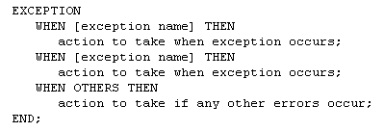
Structure of Exception Section

Slide 6
DECLARE
num_row number_table%ROWTYPE;
BEGIN
select *
into num_row
from number_table;
dbms_output.put_line(1/num_row.num);
EXCEPTION
WHEN NO_DATA_FOUND THEN
dbms_output.put_line('No data!');
WHEN TOO_MANY_ROWS THEN
dbms_output.put_line('Too many!');
WHEN OTHERS THEN
dbms_output.put_line(‘Error’);
end;

Slide 7
User-Defined Exception
DECLARE
e_number1 EXCEPTION;
cnt NUMBER;
BEGIN
select count(*)
into cnt
from number_table;
IF cnt = 1 THEN RAISE e_number1;
ELSE dbms_output.put_line(cnt);
END IF;
EXCEPTION
WHEN e_number1 THEN
dbms_output.put_line('Count = 1');
end;

Slide 8
Stored Procedures
The first line is called the Procedure Specification
The remainder is the Procedure Body
A procedure is compiled and loaded in the database as an object
Procedures can have parameters passed to them

Slide 9
Cursors
Cursors Hold Result of an SQL Statement
Two Types of Cursors in PL/SQL
Implicit – Automatically Created When a Query or Manipulation is for a Single Row
Explicit – Must Be Declared by the User
Creates a Unit of Storage Called a Result Set

Slide 10
Cursors
Result Set
MIS380 DATABASE DESIGN 4
MIS202 INFORMATION SYSTEMS 3 <Cursor
MIS485 MANAGING TECHNOLOGY 4
MIS480 ADVANCED DATABASE 4

Slide 11
Cursors
Declaring an Explicit Cursor
CURSOR CursorName IS SelectStatement;
Opening an Explicit Cursor
OPEN CursorName;
Accessing Rows from an Explicit Cursor
FETCH CursorName INTO RowVariables;

Slide 12
Cursors
Declaring Variables of the Proper Type with %TYPE
VarName TableName.FieldName%TYPE;
Declaring Variables to Hold An Entire Row
VarName CursorName%ROWTYPE;
Releasing the Storage Area Used by an Explicit Cursor
CLOSE CursorName;

Slide 13
Iterative Structures
LOOP … EXIT … END LOOP
EXIT with an If Avoids Infinite Loop
LOOP … EXIT WHEN … END LOOP
Do Not Need An If to Control EXIT
WHILE … LOOP … END LOOP
Eliminates Need for EXIT
FOR … IN … END LOOP
Eliminates Need for Initialization of Counter

Slide 14
Cursor Control With Loops
Need a Way to Fetch Repetitively
Need a Way to Determine How Many Rows to Process With a Cursor
Cursor Attributes
CursorName%ROWCOUNT – Number of Rows in a Result Set
CursorName%FOUND – True if a Fetch Returns a Row
CursorName%NOTFOUND – True if Fetch Goes Past Last Row

Slide 15
Cursor For Loop
Processing an Entire Result Set Common
Special Form of FOR … IN to Manage Cursors
No Need for Separate OPEN, FETCH and CLOSE statements
Requires %ROWTYPE Variable

Slide 16
Stored Procedures
Run a procedure with the PL/SQL EXECUTE command
Parameters are enclosed in parentheses

Slide 17
Stored Functions
Like a procedure except they return a single value

Slide 18
Triggers
Associated with a particular table
Automatically executed when a particular event occurs
Insert
Update
Delete
Others

Slide 19
Triggers vs. Procedures
Procedures are explicitly executed by a user or application
Triggers are implicitly executed (fired) when the triggering event occurs
Triggers should not be used as a lazy way to invoke a procedure as they are fired every time the event occurs

Slide 20
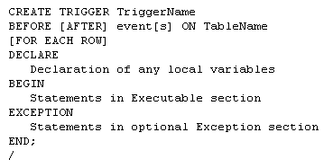
Triggers

Slide 21
Triggers
The trigger specification names the trigger and indicates when it will fire
The trigger body contains the PL/SQL code to accomplish whatever task(s) need to be performed

Slide 22
Triggers

Slide 23
Triggers Timing
A triggers timing has to be specified first
Before (most common)
Trigger should be fired before the operation
i.e. before an insert
After
Trigger should be fired after the operation
i.e. after a delete is performed

Slide 24
Trigger Events
Three types of events are available
DML events
DDL events
Database events

Slide 25
DML Events
Changes to data in a table
Insert
Update
Delete

Slide 26
DDL Events
Changes to the definition of objects
Tables
Indexes
Procedures
Functions
Others
Include CREATE, ALTER and DROP statements on these objects

Slide 27
Database Events
Server Errors
Users Log On or Off
Database Started or Stopped

Slide 28
Trigger DML Events
Can specify one or more events in the specification
i.e. INSERT OR UPDATE OR DELETE
Can specify one or more columns to be associated with a type of event
i.e. BEFORE UPDATE OF SID OR SNAME

Slide 29
Table Name
The next item in the trigger is the name of the table to be affected

Slide 30
Trigger Level
Two levels for Triggers
Row-level trigger
Requires FOR EACH ROW clause
If operation affects multiple rows, trigger fires once for each row affected
Statement-level trigger
DML triggers should be row-level
DDL and Database triggers should not be row-level

Slide 31
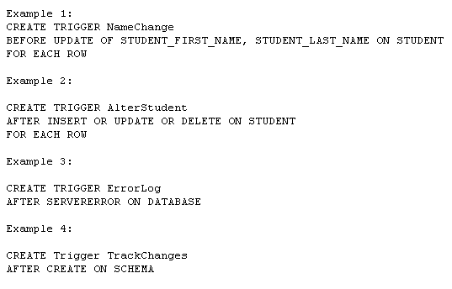
Event Examples

Slide 32
Triggers
Conditions Available So Multiple Operations Can Be Dealt With In Same Trigger
Inserting, Updating, Deleting
Column Prefixes Allow Identification Of Value Changes
New, Old

Slide 33
Triggers Exceptions
EXCEPTION Data Type Allows Custom Exceptions
RAISE Allows An Exception To Be Manually Occur
RAISE_APPLICATION_ERROR Allows Termination Using A Custom Error Message
Must Be Between -20000 and -20999
Message Can Be Up to 512 Bytes

Slide 34
Cursors
Cursors Hold Result of an SQL Statement
Two Types of Cursors in PL/SQL
Implicit – Automatically Created When a Query or Manipulation is for a Single Row
Explicit – Must Be Declared by the User
Creates a Unit of Storage Called a Result Set

Slide 35
Cursors
Result Set
MIS380 DATABASE DESIGN 4
MIS202 INFORMATION SYSTEMS 3 <Cursor
MIS485 MANAGING TECHNOLOGY 4
MIS480 ADVANCED DATABASE 4

Slide 36
Cursors
Declaring an Explicit Cursor
CURSOR CursorName IS SelectStatement;
Opening an Explicit Cursor
OPEN CursorName;
Accessing Rows from an Explicit Cursor
FETCH CursorName INTO RowVariables;

Slide 37
Cursors
Declaring Variables of the Proper Type with %TYPE
VarName TableName.FieldName%TYPE;
Declaring Variables to Hold An Entire Row
VarName CursorName%ROWTYPE;
Releasing the Storage Area Used by an Explicit Cursor
CLOSE CursorName;

Slide 38
Iterative Structures
LOOP … EXIT … END LOOP
EXIT with an If Avoids Infinite Loop
LOOP … EXIT WHEN … END LOOP
Do Not Need An If to Control EXIT
WHILE … LOOP … END LOOP
Eliminates Need for EXIT
FOR … IN … END LOOP
Eliminates Need for Initialization of Counter

Slide 39
Cursor Control With Loops
Need a Way to Fetch Repetitively
Need a Way to Determine How Many Rows to Process With a Cursor
Cursor Attributes
CursorName%ROWCOUNT – Number of Rows in a Result Set
CursorName%FOUND – True if a Fetch Returns a Row
CursorName%NOTFOUND – True if Fetch Goes Past Last Row

Slide 40
Cursor For Loop
Processing an Entire Result Set Common
Special Form of FOR … IN to Manage Cursors
No Need for Separate OPEN, FETCH and CLOSE statements
Requires %ROWTYPE Variable

